Slide 1

Case ID #
School
Date

Slide 2
Notes:
Initial Records:
Patient Age
Chief Complaint
Facial Photos
Intraoral Photos
Dental Models
Lateral Cephalometric Radiograph and Tracing
Panorex

Slide 3
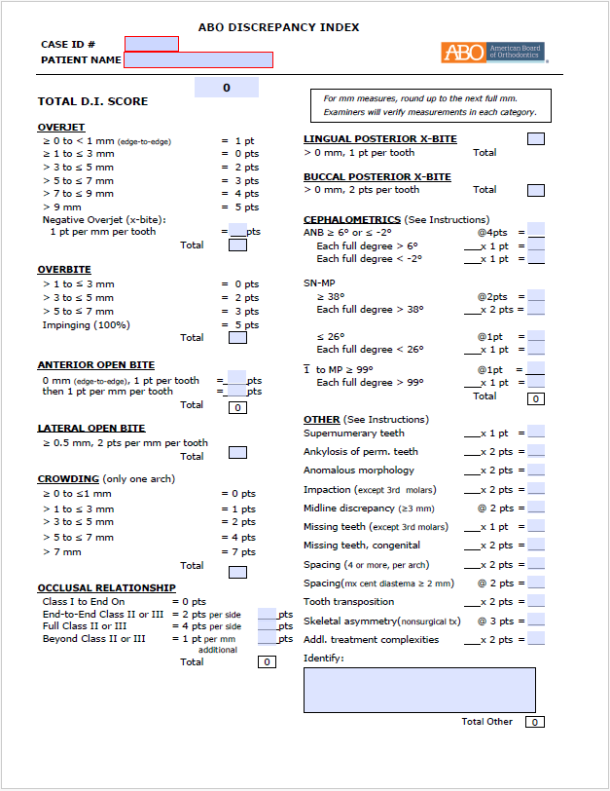
0
Notes:
Discrepancy Index
Total DI Score

Slide 4

ABO Clinical Exam Domains | Weighted %
1. Data Gathering and Diagnosis | 25%
2. Treatment Objectives and Planning | 25%
3. Treatment Implementation and Management | 25%
4. Critical Analysis and Outcomes Assessment | 25%
Notes:
Domain 1: Data Gathering and Diagnosis

Slide 5
Notes:
Skeletal Problems
Dental Problems
Soft Tissue/Facial Problems

Slide 6
ABO Clinical Exam Domains | Weighted %
1. Data Gathering and Diagnosis | 25%
2. Treatment Objectives and Planning | 25%
3. Treatment Implementation and Management | 25%
4. Critical Analysis and Outcomes Assessment | 25%
Notes:
Domain 2: Treatment Objectives and Planning

Slide 7
Notes:
Primary Treatment Plan (with Alternatives if applicable)

Slide 8
ABO Clinical Exam Domains | Weighted %
1. Data Gathering and Diagnosis | 25%
2. Treatment Objectives and Planning | 25%
3. Treatment Implementation and Management | 25%
4. Critical Analysis and Outcomes Assessment | 25%
Notes:
Domain 3: Treatment Implementation and Management

Slide 9
Notes:
Implementation
Interim Photos
Patient Age
Facial Photos
Intraoral Photos
Dental Models
Lateral Cephalometric Radiograph and Tracing
Panorex

Slide 10
ABO Clinical Exam Domains | Weighted %
1. Data Gathering and Diagnosis | 25%
2. Treatment Objectives and Planning | 25%
3. Treatment Implementation and Management | 25%
4. Critical Analysis and Outcomes Assessment | 25%
Notes:
Domain 4: Critical Analysis and Outcomes Assessment

Slide 11
Notes:
Final Photos
Patient Age
Facial Photos
Intraoral Photos
Dental Models
Lateral Cephalometric Radiograph
Cephalometric Superimposition
Panorex

Slide 12
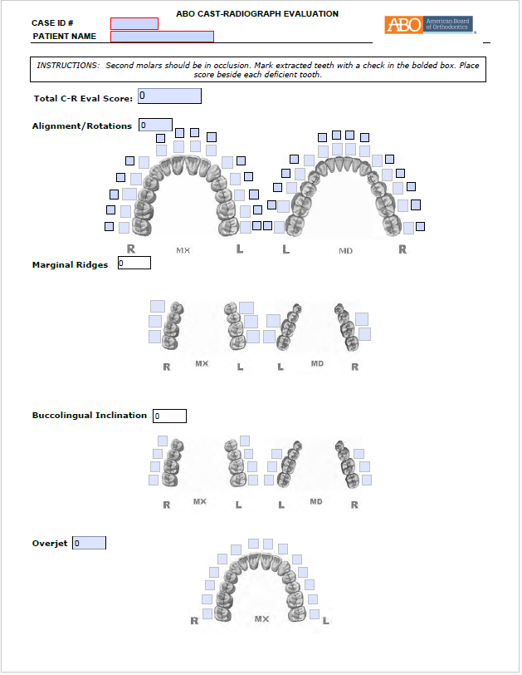
0
Notes:
Cast Radiograph Evaluation
Total C-R Eval Score

Slide 13
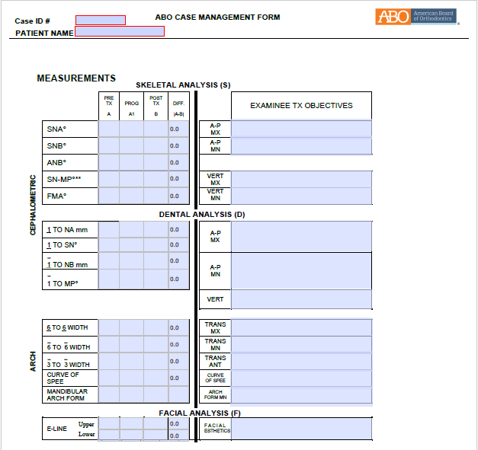
Notes:
Case Management Form

